Slide 1

IMDb Movies Analysis
Karolina Szczepanik
ECO 590

Slide 2
Motivation / Research Question
Motivation
IMDb ratings influence how audiences perceive movies
I wanted to explore whether movie characteristics relate to higher ratings
Used OMDb API data to analyze patterns across 100 films
Research Question
What movie characteristics are associated with higher IMDb ratings?
This project will examine how film characteristics such as awards recognition, runtime, genre complexity, and release year are associated with variation in IMDb ratings.

Slide 3
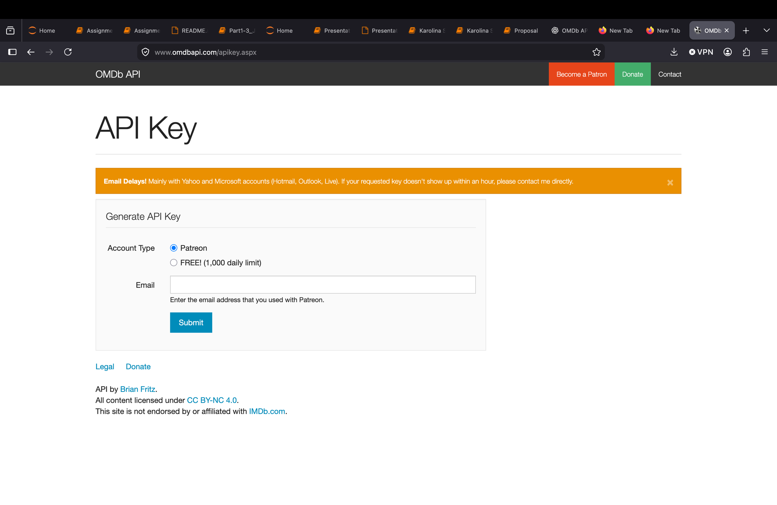
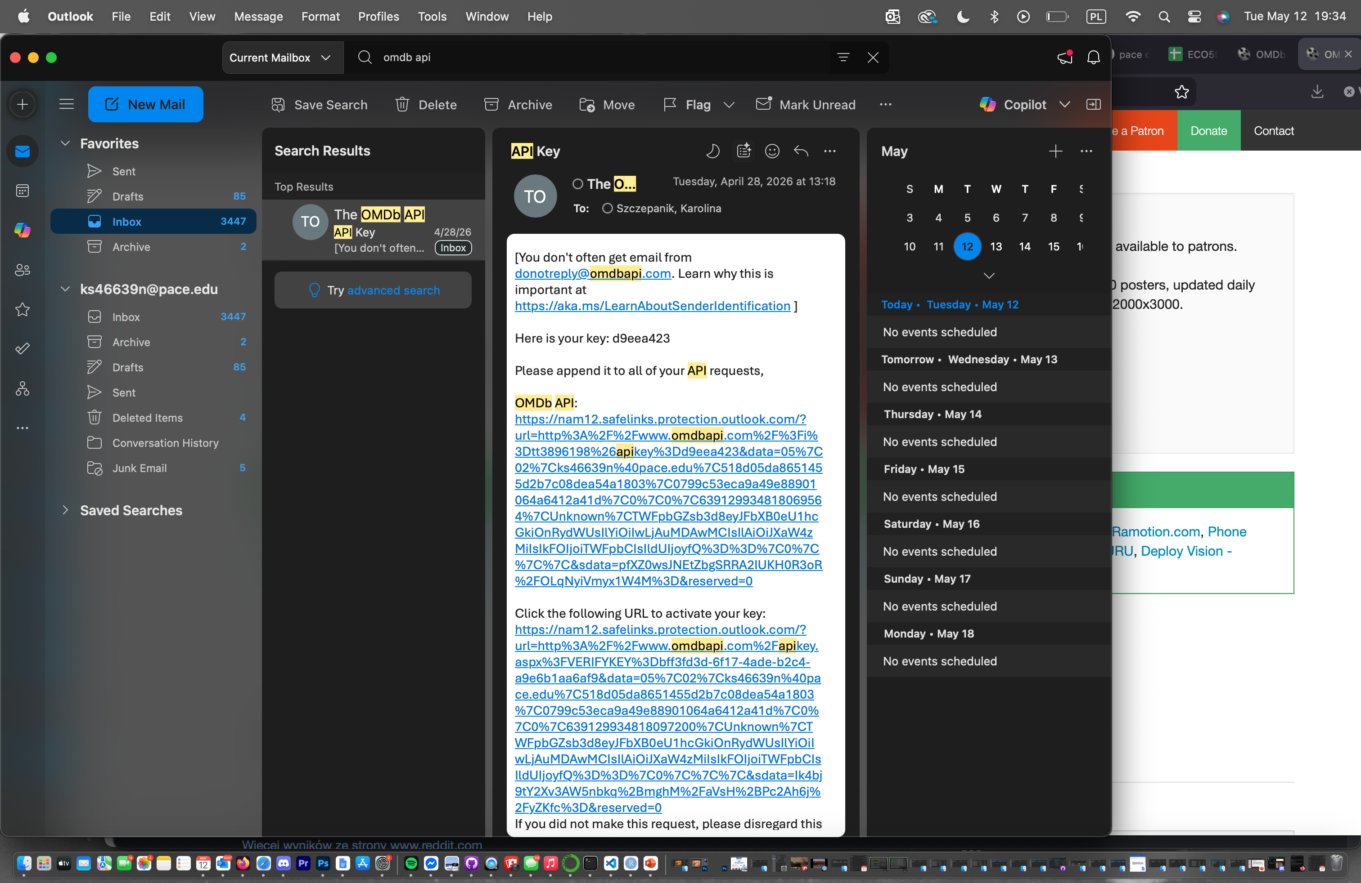
Data Collection / API Process
Collecting Data from the OMDb API
Used the OMDb API (Open Movie Database)

Slide 4
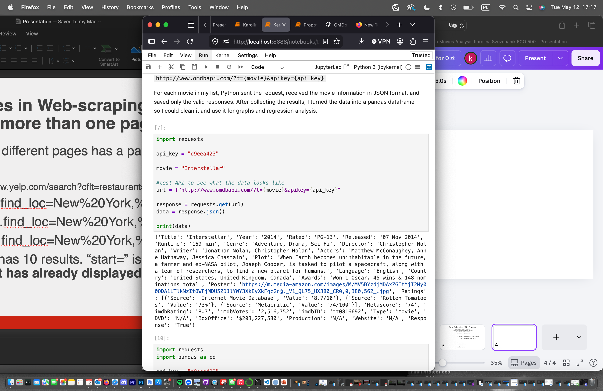
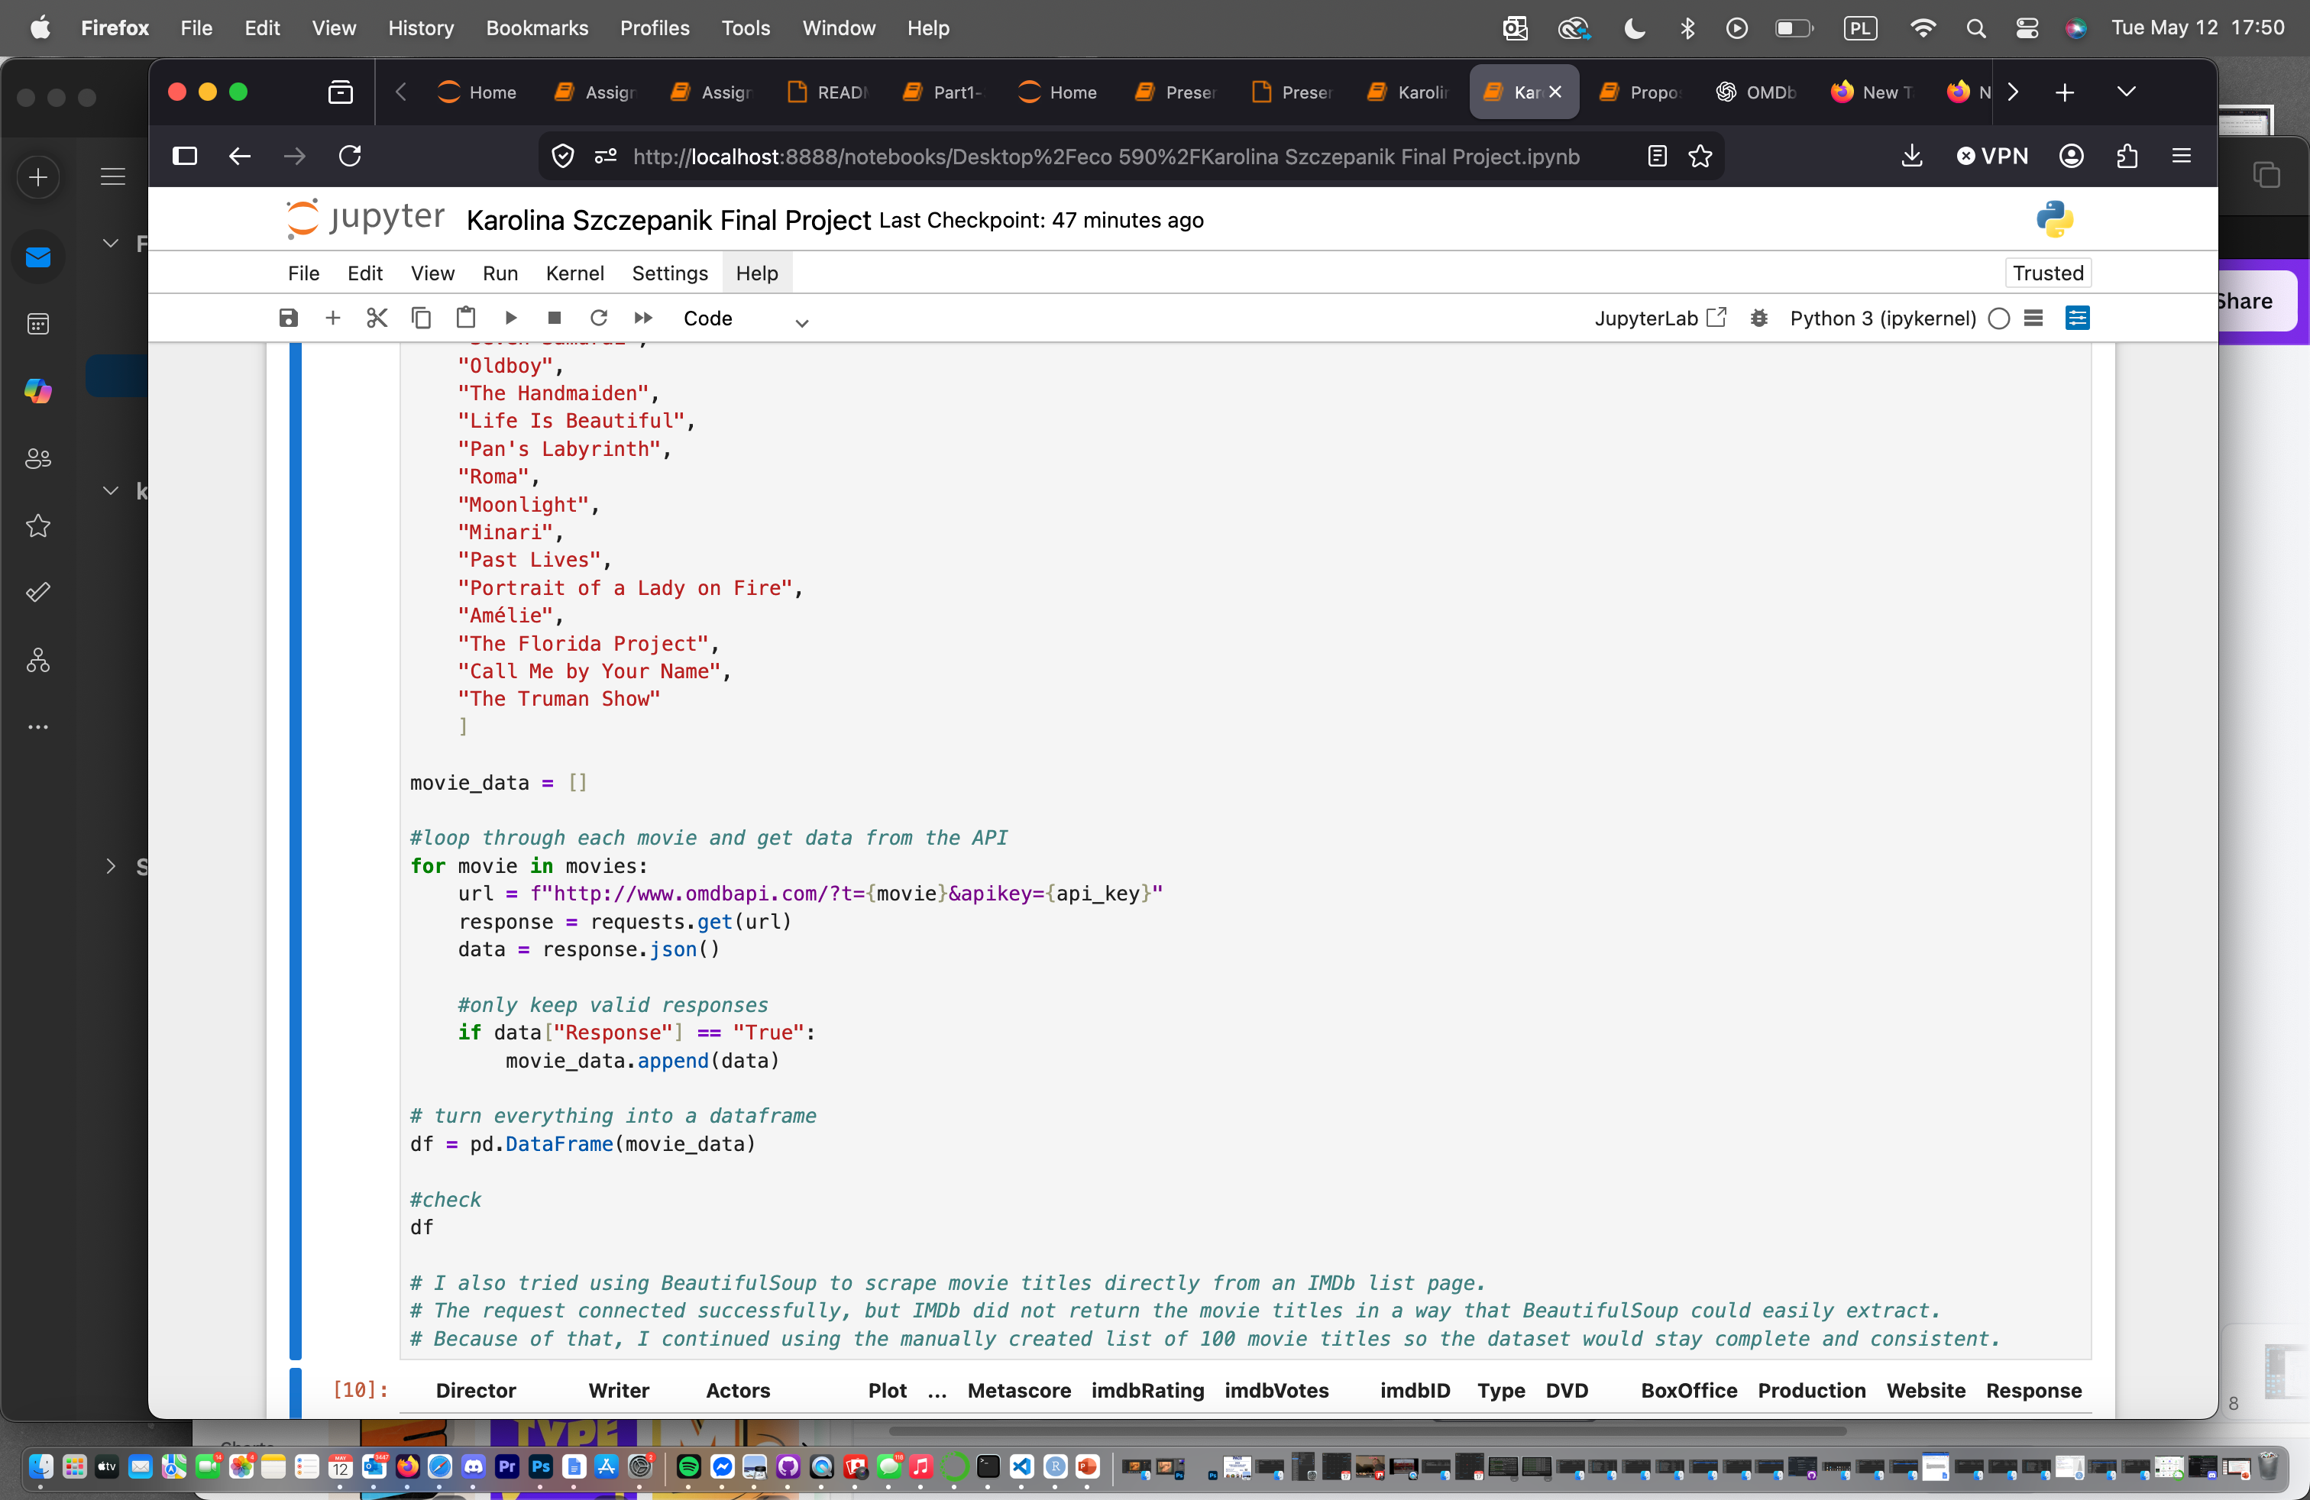
Python sent a request for each movie title
Data was returned in JSON format
I first tested the API using one movie, Interstellar, to understand how the JSON response was structured before collecting all 100 movies.”
Created a list of 100 movie titles
Generated API requests using Python loops and the OMDb API

Slide 5
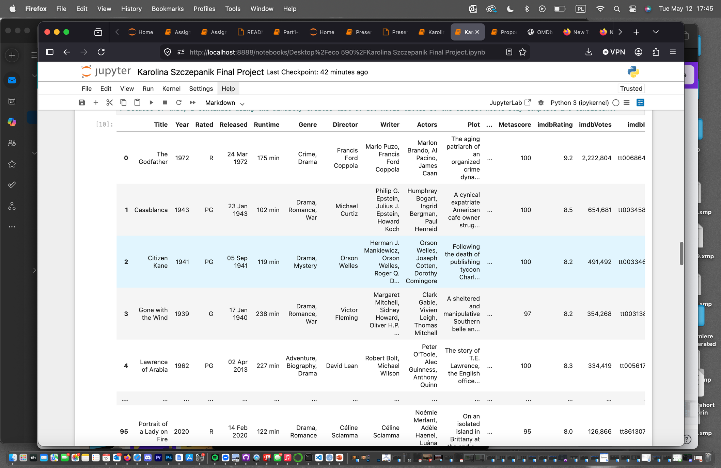
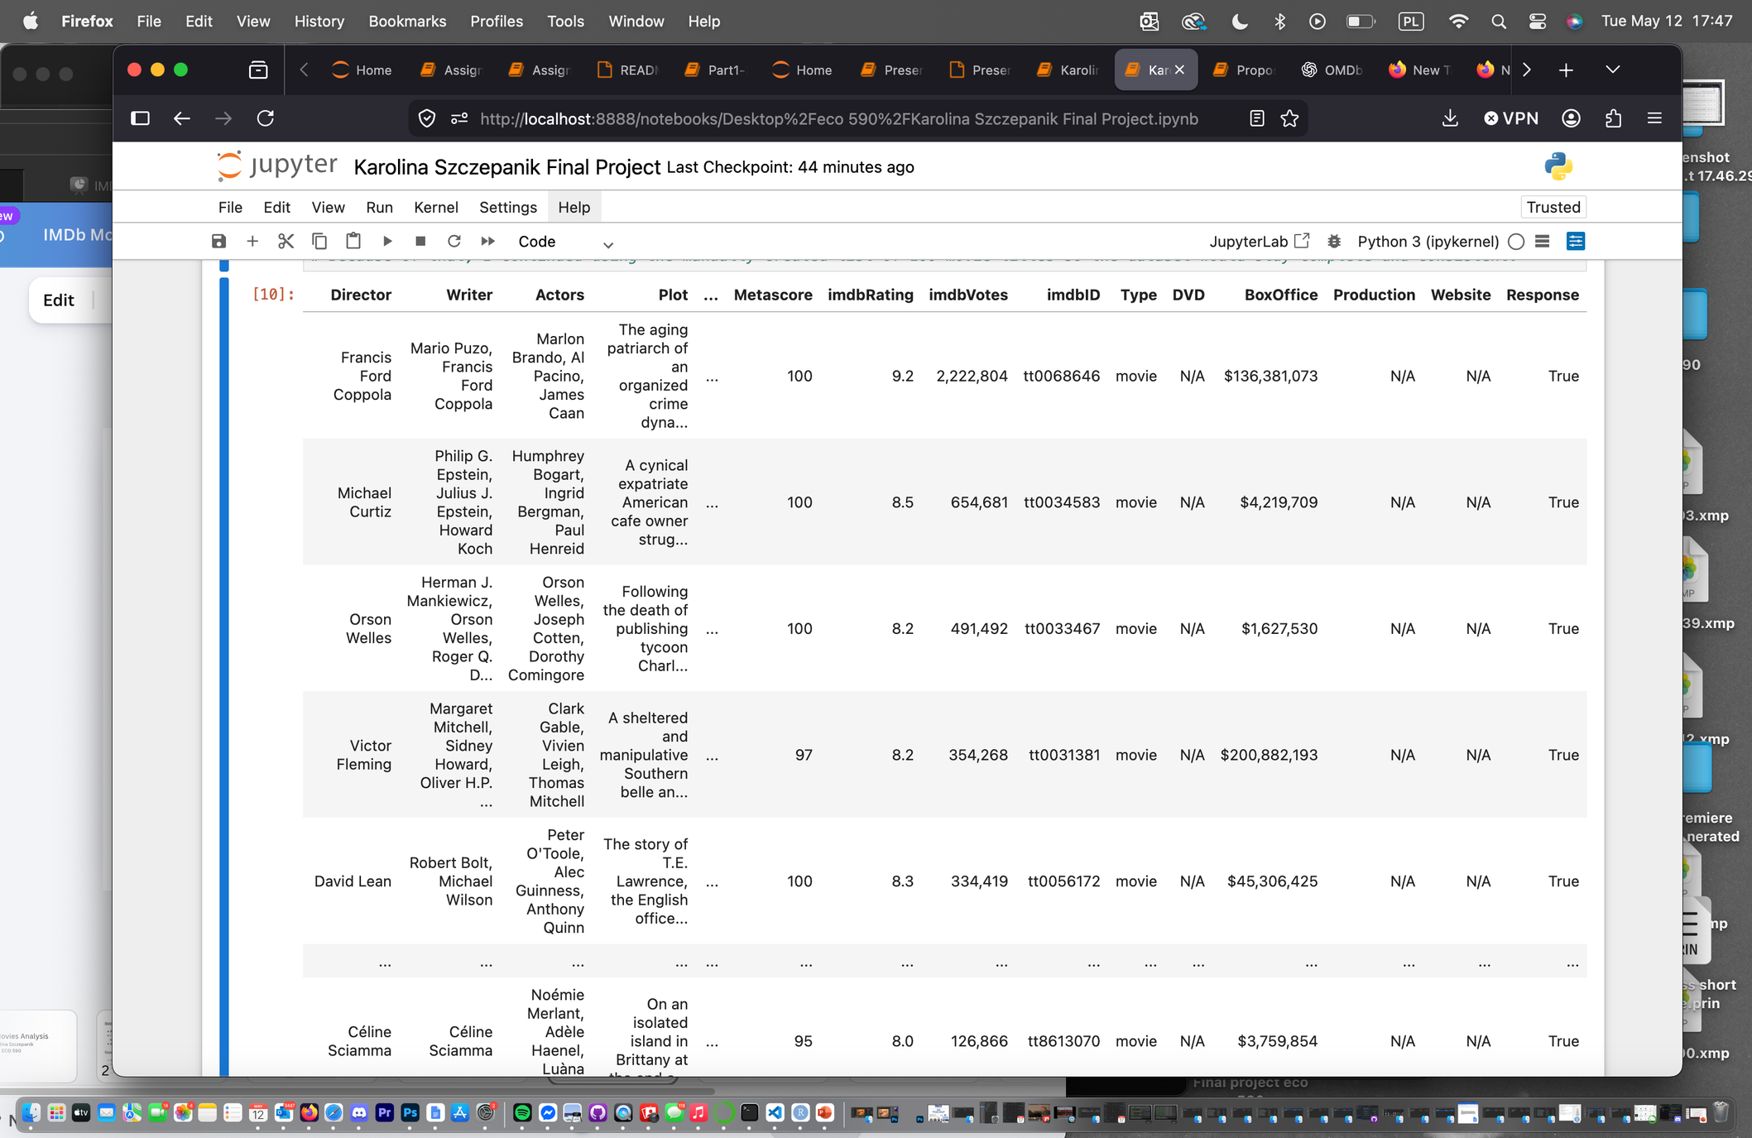
Collected Movie Dataset
The final dataset included movie information such as ratings, runtime, genre, awards, and release year

Slide 6
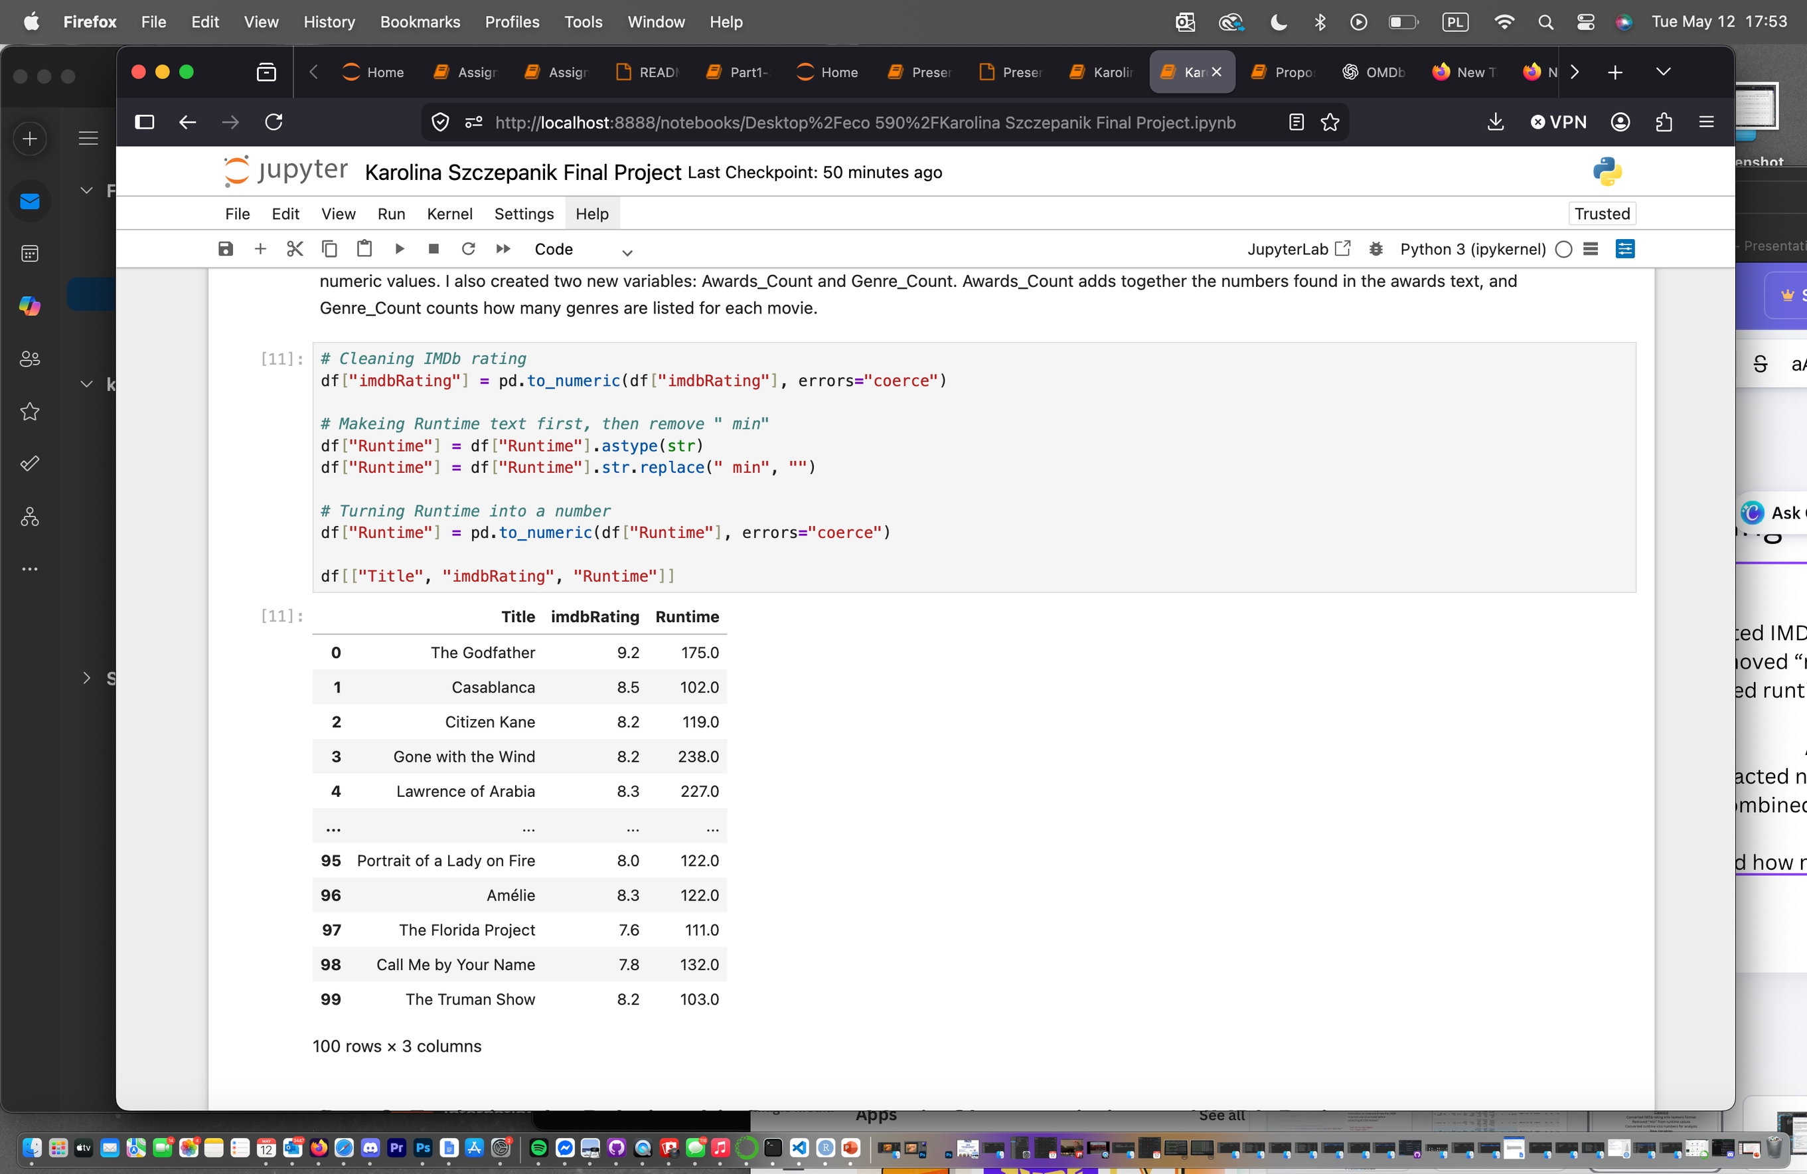
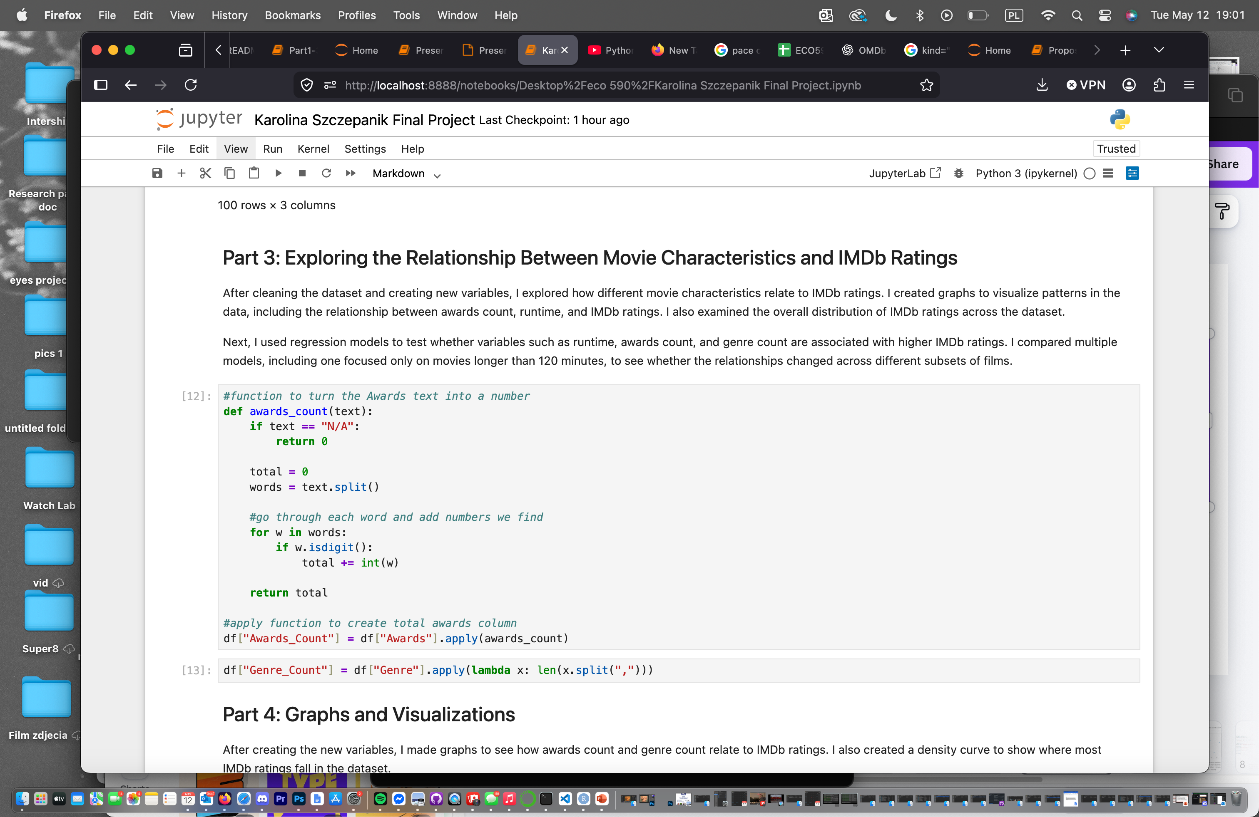
Cleaning & Variable Creation
Converted IMDb ratings and runtime into numeric values
Removed “min” from runtime using string cleaning
Created Awards_Count by extracting numbers from awards text
Created Genre_Count to measure genre complexity
New variables were later used in graphs and regression models
Cleaned the dataset so it could be analyzed in Python and R

Slide 7
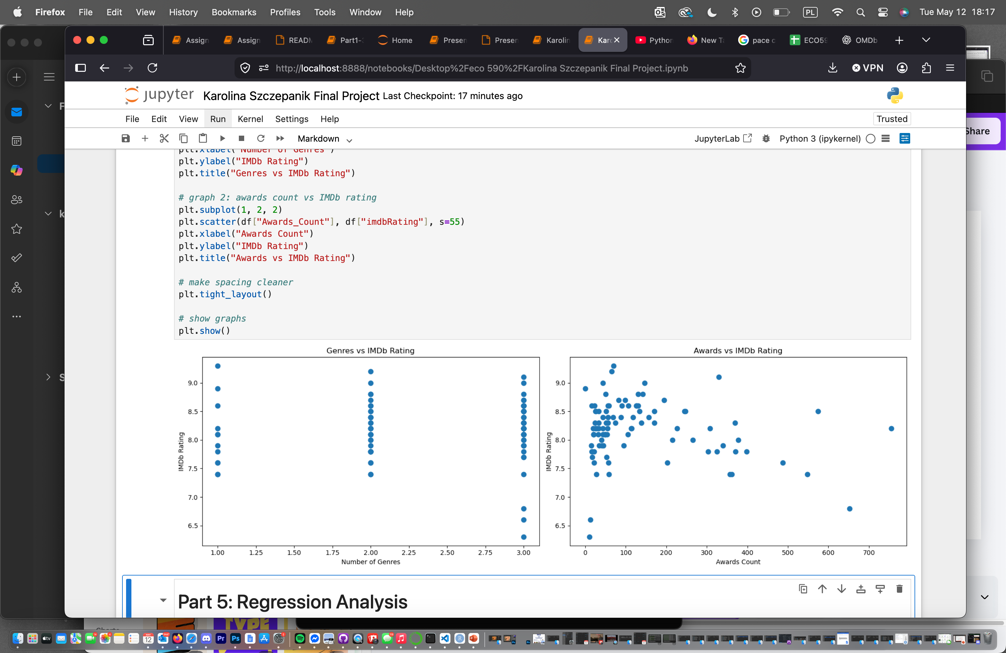
Graphs
IScatterplots were used to explore relationships between IMDb ratings and movie characteristics.
This graph compares the number of genres each movie has with its IMDb rating. Movies with more genres did not always receive higher ratings, showing only a weak relationship.
This graph shows the relationship between awards count and IMDb ratings. Movies with more awards generally tended to have slightly higher ratings, although the relationship was not very strong.

Slide 8
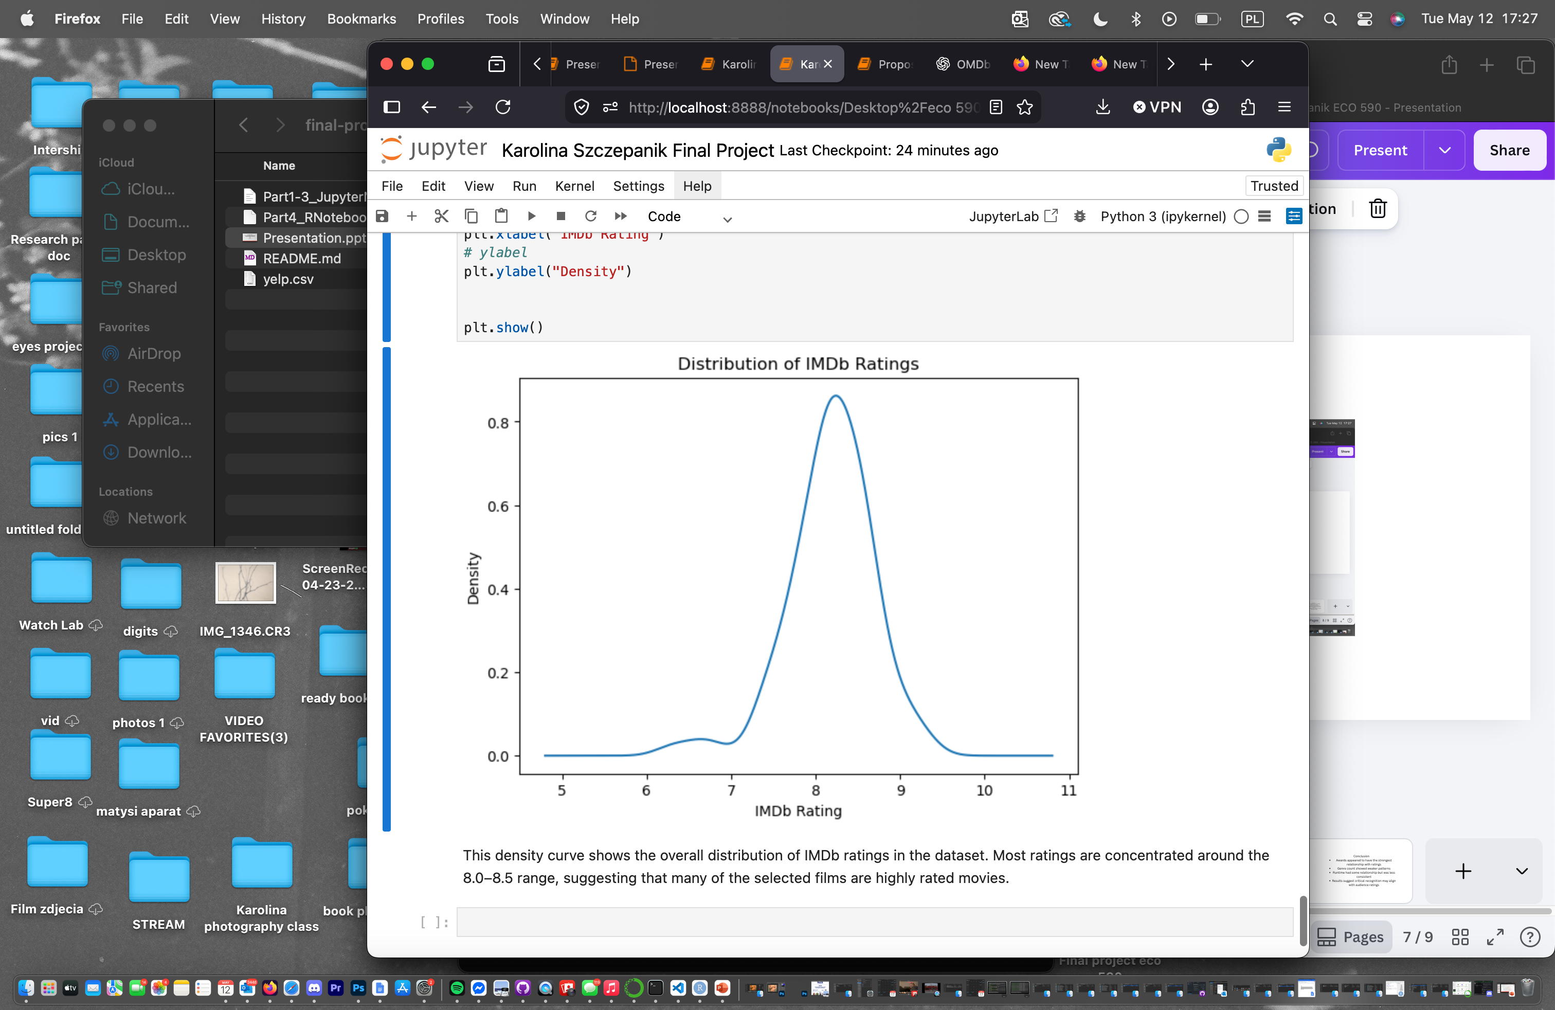
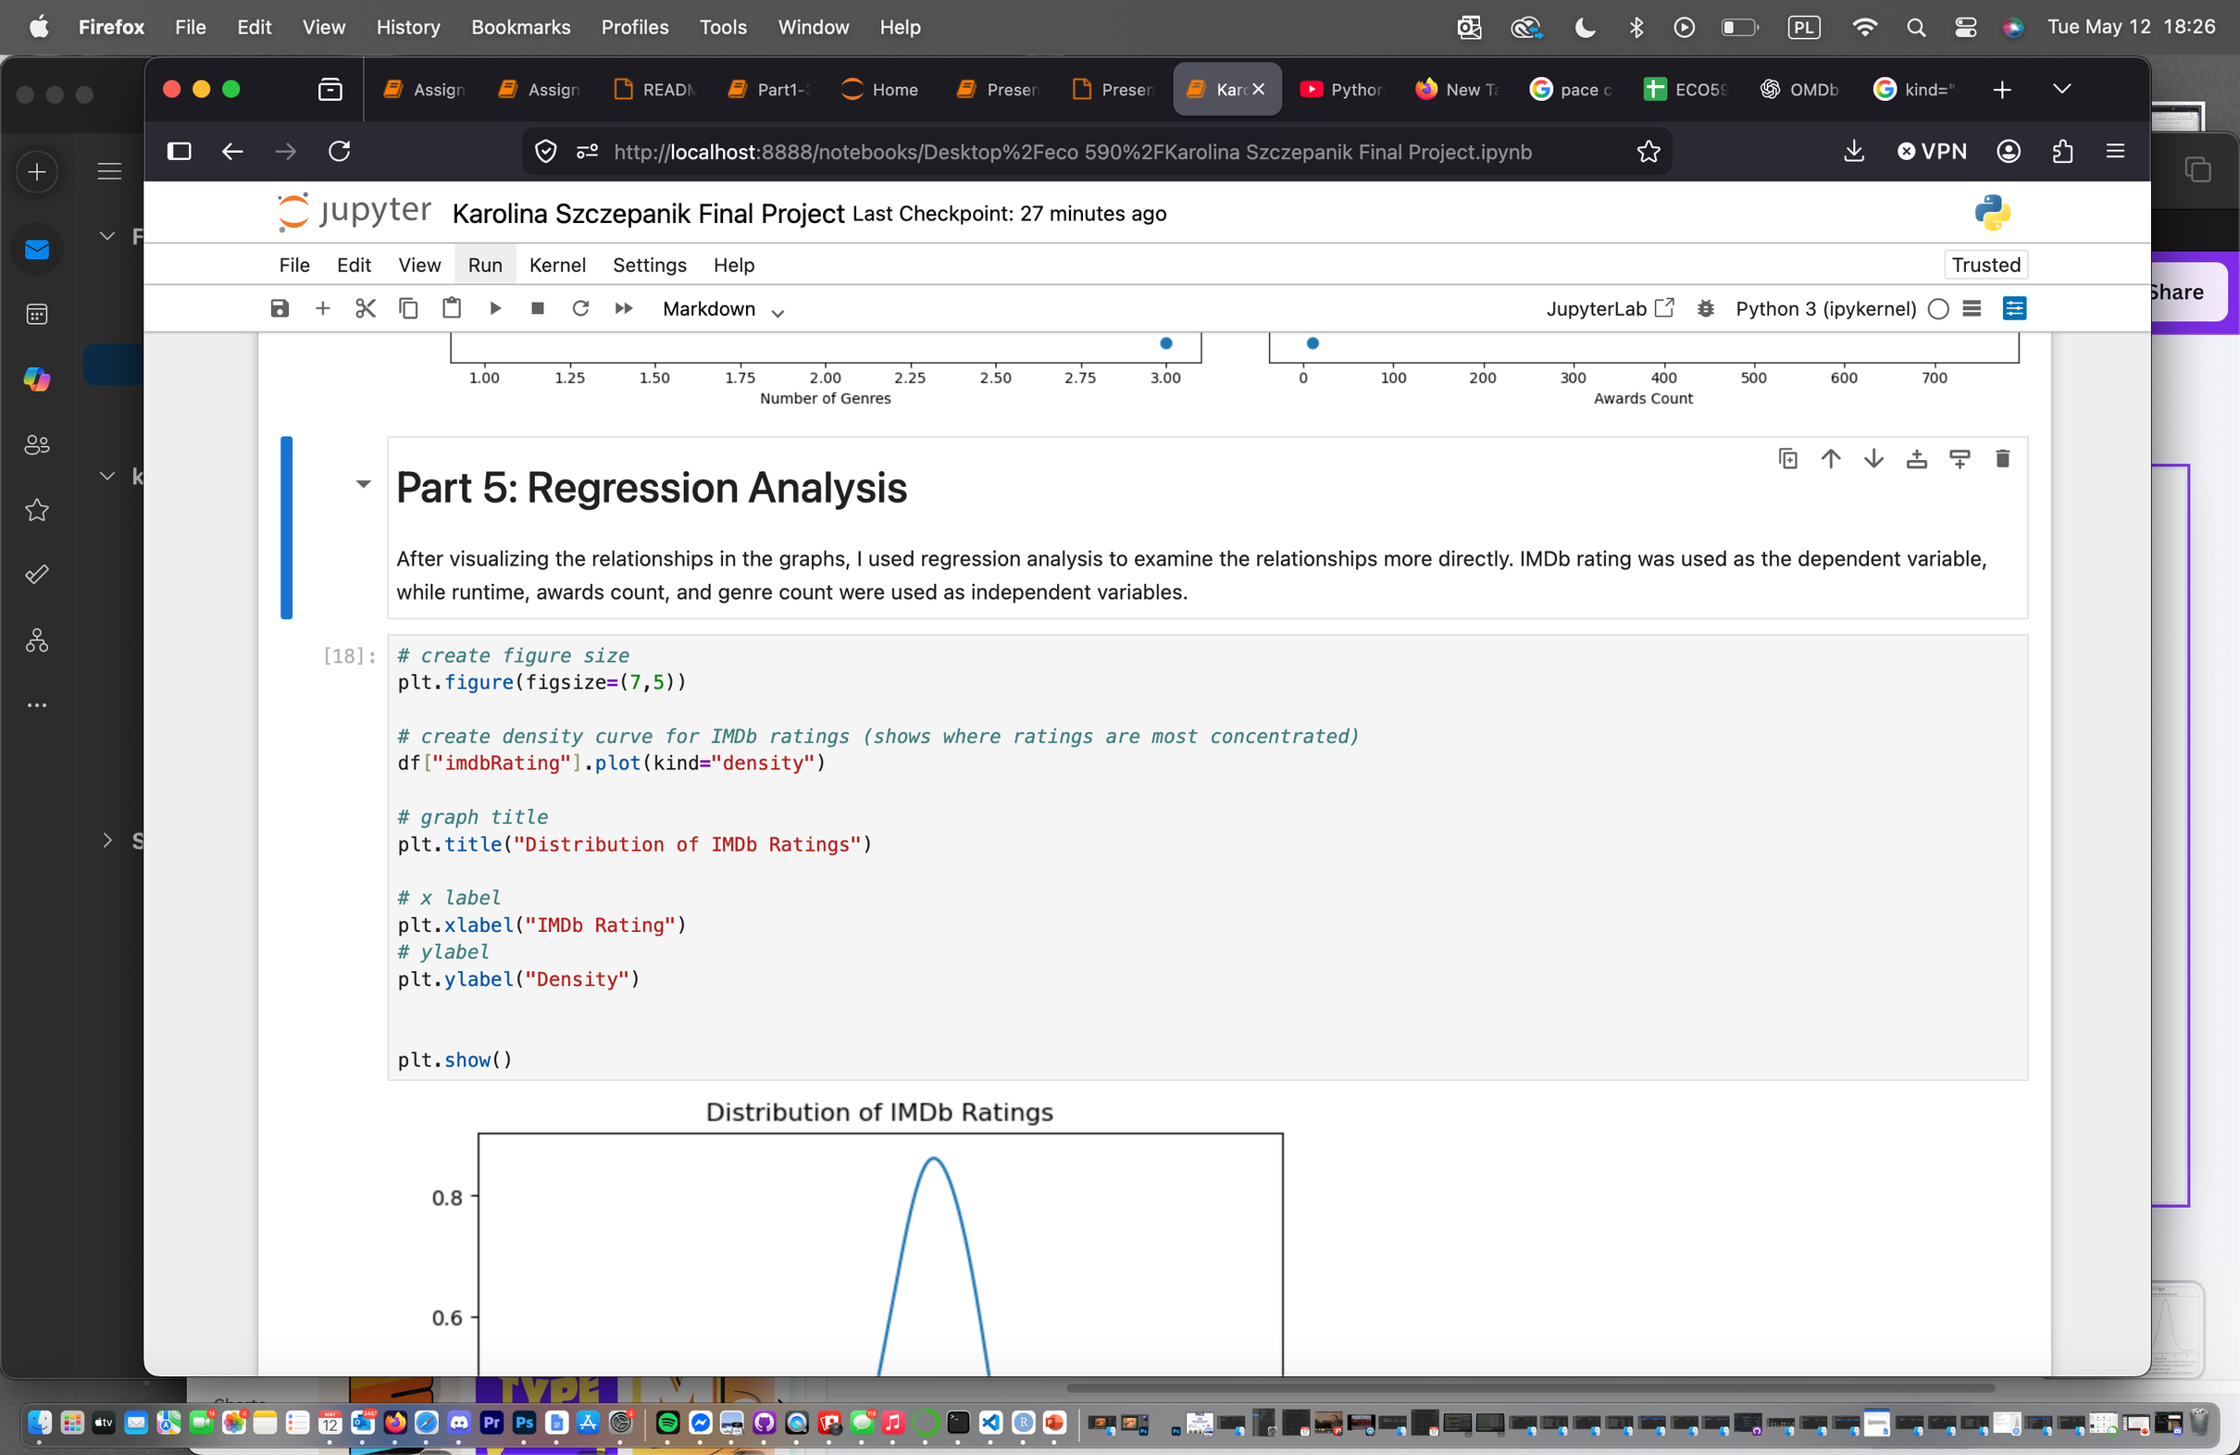
Distribution of IMDb Ratings
Most IMDb ratings were concentrated between 7.5 and 8.5, shown by the peak in the center of the curve.
The distribution suggests that the dataset mainly included well-rated and critically recognized films.
Very low IMDb ratings were uncommon, while extremely high ratings were also rare.
The density curve helped visualize where ratings were most heavily concentrated across the dataset.

Slide 9
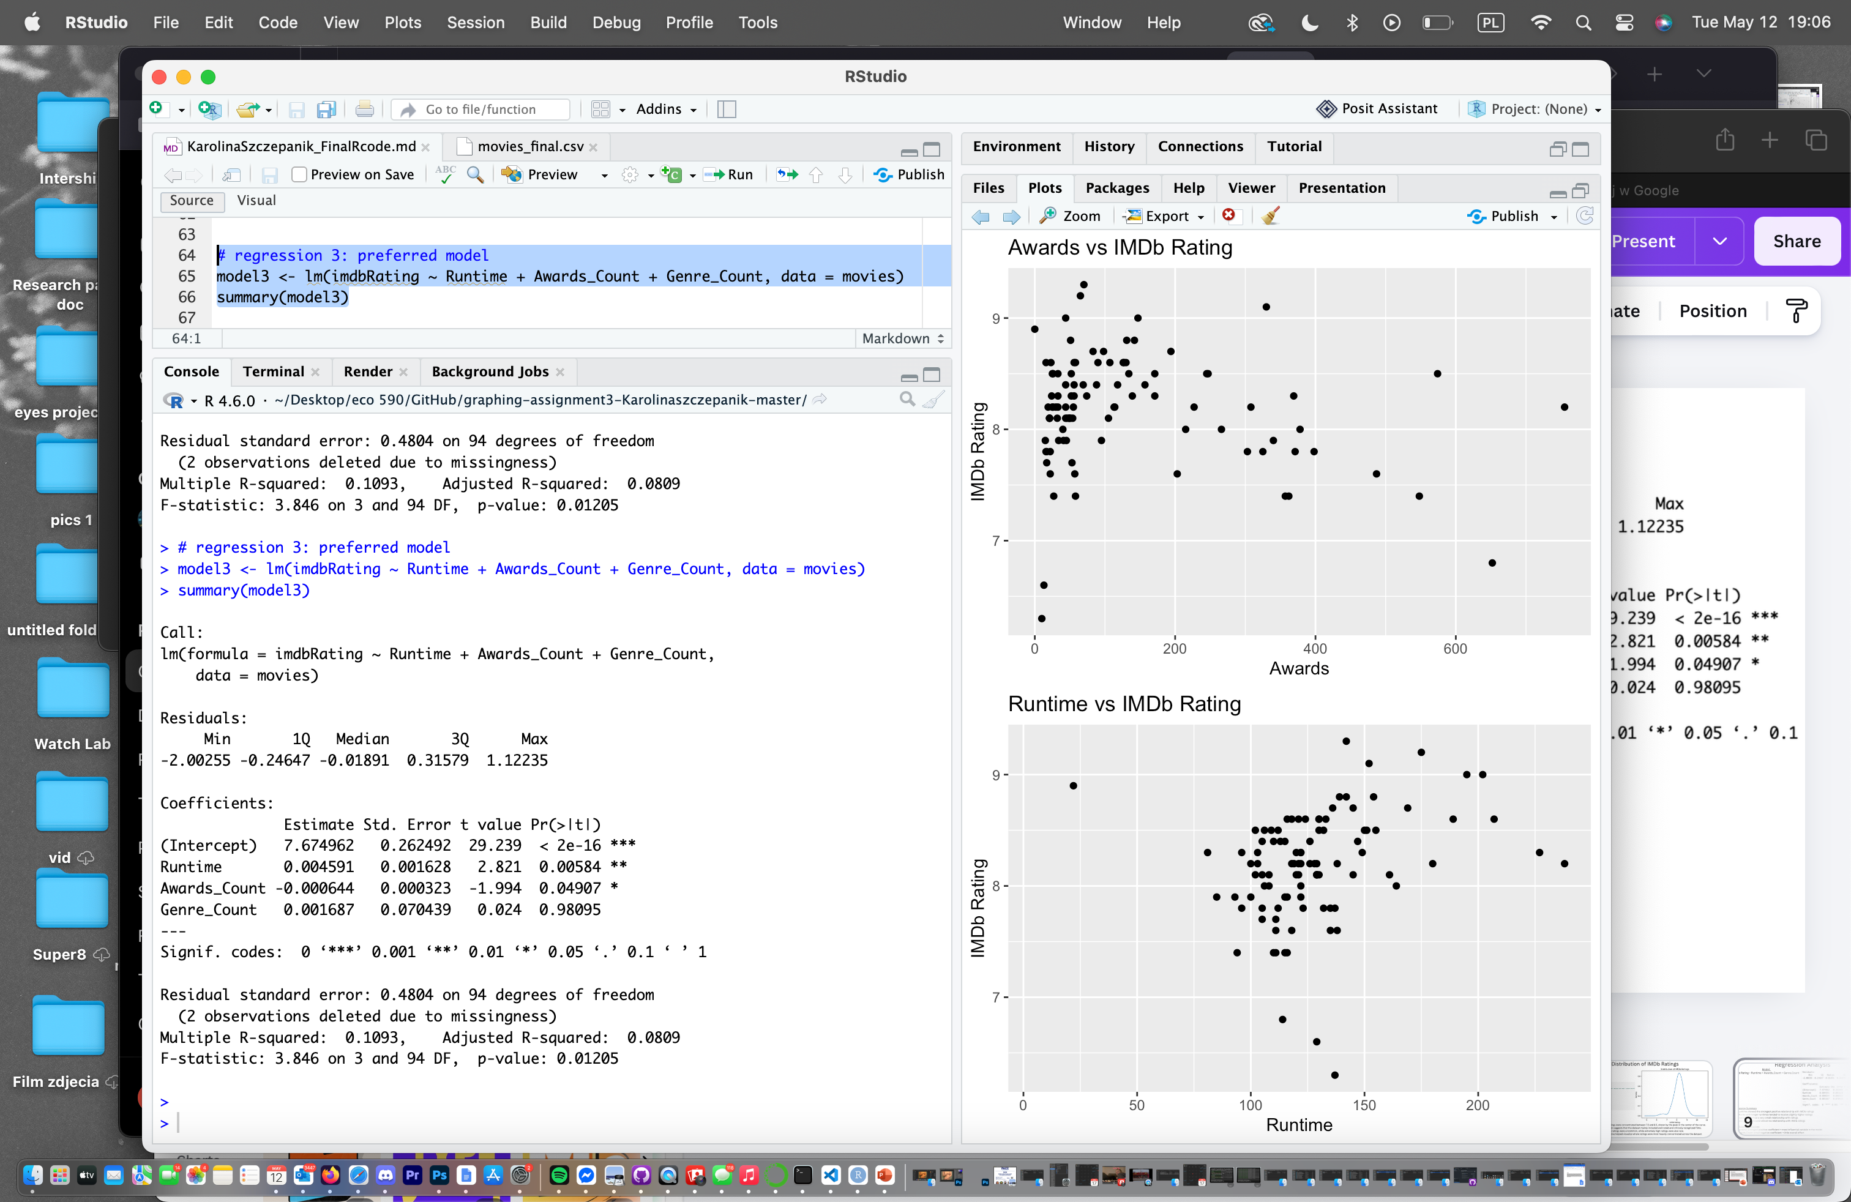
Regression Analysis
Model:
IMDb Rating ~ Runtime + Awards_Count + Genre_Count
Regression Summary
Runtime had the strongest positive relationship with IMDb ratings.
The coefficient was positive (0.0046), suggesting that longer movies tended to receive slightly higher ratings.
Awards_Count showed a small negative relationship with IMDb ratings.
Its coefficient was close to zero (-0.0006), meaning awards did not strongly predict ratings in this dataset.
Genre_Count showed almost no relationship with IMDb ratings.
The coefficient (0.0017) was very small, suggesting the number of genres a movie had did not meaningfully affect ratings.

Slide 10

Conclusion
Runtime showed the strongest relationship with IMDb ratings
Awards count and genre count had weaker effects on ratings
Most ratings were concentrated between 8.0 and 8.5

